Slide 1

SOFTWARE ENGINEERING AND PROJECT MANAGEMENT
(CSE 227)
Facilitator:
Dr.S.Senthilkumar
Department of Computer Science and Engineering
School of Engineering,
PRESIDENCY UNIVERSITY

Slide 2
TEXT BOOK AND REFERENCE BOOKS
REFERENCE MATERIALS:
Text book(s):
Roger S. Pressman, “Software Engineering – A Practitioner’s Approach”, VII Edition, McGraw-Hill, 2017.
Bob Hughes, Mike Cotterell, Rajib Mall, “Software Project Management”, VI Edition, McGraw-Hill, 2018.
Reference book(s):
Ian Sommerville, “Software Engineering”, IX Edition, Pearson Education Asia, 2011.
Rajib Mall, “Fundamentals of Software Engineering”, VI Edition, PHI learning private limited, 2014.
Dept. of CSE, SOE, Presidency University

Slide 3
Assessment Schedule
Sl.no | Assessment type | Contents | Course outcome Number | Duration In Hours | Marks | weightage | Venue, DATE &TIME
1 | Quiz I [Informal] | Modules 1 | CO1 | 1 | 10 | 5% | Announce Later
2 | Quiz II [Informal] | Modules 2 | CO2 | 1 | 10 | 5%
3 | Test-1 [Formal] | Modules 1 & 2 | CO1 CO2 | 1 | 40 | 20%
4 | Assignment | Module 3 | CO3 | 1 | 10 | 5%
5 | Test-2 [Formal] | Modules 3 & 4 | CO3 CO4 | 1 | 40 | 20%
6 | Case Study | Module 4 | CO4 | 1 | 10 | 5%
7 | End Term Exam [Formal] | Modules 1 – 4 | CO1-CO4 | 3 | 80 | 40%
Dept. of CSE, SOE, Presidency University

Slide 4
CHAPTER 1 - CONTENTS
What is Software?
Nature of Software or Software characteristics
Software Application Domains
Legacy Software
Characteristics of WebApps
What is Software Engineering?
Layered Technology
Software Process Framework
Umbrella activities in the Software Process
Essence of Software Practice
Software Myths
Dept. of CSE, SOE, Presidency University

Slide 5
1. What is Software?
Software is:
instructions (computer programs) that when executed provide desired features, function, and performance;
data structures that enable the programs to adequately manipulate information and
documentation that describes the operation and use of the programs.
Software plays a dual role of being a “product” and also a “vehicle for delivering a product”.
Dept. of CSE, SOE, Presidency University

Slide 6
2. Nature of Software or Characteristics
Software is developed or engineered, it is not manufactured in the classical sense.
Software doesn't "wear out."
Although the industry is moving toward component-based construction, most software continues to be custom-built.
Dept. of CSE, SOE, Presidency University

Slide 7
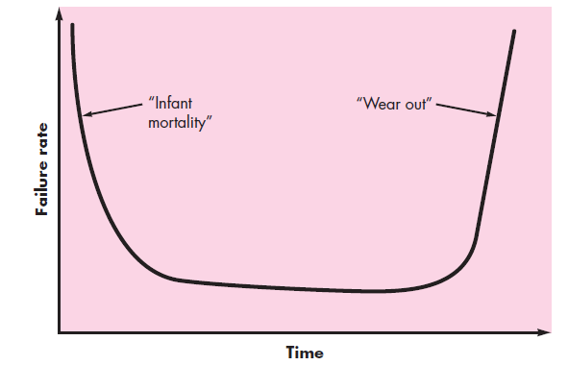

Hardware vs. Software Failures
Hardware components suffer from the cumulative effects of dust, vibration, abuse, temperature extremes
Design or
manufacturing defects
Changes in the software
Failure Curve for Hardware
Uncovering defects
Failure Curve for Software
Dept. of CSE, SOE, Presidency University

Slide 8
3. Software Application Domains
System Software : Require heavy interaction with computer hardware
Ex: Operating Systems like Windows, Ubuntu, Android, iOS
Application Software : Stand alone programs that solve business need
Ex: Microsoft Office applications such as Word, Excel, PowerPoint
Engineering/Scientific software : Required for high performance scientific computing
Ex: Computer Aided Design (CAD) software, MATLAB, Julia
Embedded Software : Software that controls machines or devices
Ex: ATMs, Braking system in car, Key pad control in Microwave Oven
Dept. of CSE, SOE, Presidency University

Slide 9
Software Application Domains
Product-line Software : Satisfies particular market segment
Ex: Walmart POS (Point of Sale) System, Metro POS System, Word
processing apps
Web Applications : Client-Server type of applications
Ex: Gmail, Google Docs, Facebook
AI Software : Expert Systems, Robotics, Pattern Recognition
Ex: Apple’s Siri (virtual assistant), IBM Watson, Google Maps
Dept. of CSE, SOE, Presidency University

Slide 10
Software - New Categories
Open world computing - pervasive, distributed computing
Ubiquitous computing - wireless networks
Netsourcing - the Web as a computing engine
Open source - ”free” source code open to the computing community (a blessing, but also a potential curse!)
Also
  Data mining
  Grid computing
  Cognitive machines
  Software for nanotechnologies
Dept. of CSE, SOE, Presidency University

Slide 11
4. Legacy Software
  Legacy software are developed decades ago and have been continually modified to meet changes in business requirements and computing platforms.
Why must it change?
  software must be adapted to meet the needs of new computing environments or technology.
  software must be enhanced to implement new business requirements.
  software must be extended to make it interoperable with other more modern systems or databases.
  software must be re-architected to make it viable within a network environment.
Dept. of CSE, SOE, Presidency University

Slide 12
5.1 Characteristics of WebApps - I
Network intensiveness. A WebApp resides on a network and must serve the needs of a diverse community of clients.
Concurrency. A large number of users may access the WebApp at one time.
Unpredictable load. The number of users of the WebApp may vary by orders of magnitude from day to day.
Performance. If a WebApp user must wait too long (for access, for server-side processing, for client-side formatting and display), he or she may decide to go elsewhere.
Availability. Although expectation of 100 percent availability is unreasonable, users of popular WebApps often demand access on a “24/7/365” basis.
Dept. of CSE, SOE, Presidency University

Slide 13
5.2 Characteristics of WebApps - II
Data driven. The primary function of many WebApps is to use hypermedia to present text, graphics, audio, and video content to the end-user.
Continuous evolution. Unlike conventional application software that evolves over a series of planned, chronologically-spaced releases, Web applications evolve continuously.
Immediacy. Although immediacy—the compelling need to get software to market quickly—is a characteristic of many application domains, WebApps often exhibit a time to market that can be a matter of a few days or weeks.
Security. Because WebApps are available via network access, it is difficult, if not impossible, to limit the population of end-users who may access the application.
Aesthetics. An undeniable part of the appeal of a WebApp is its look and feel.
Dept. of CSE, SOE, Presidency University

Slide 14
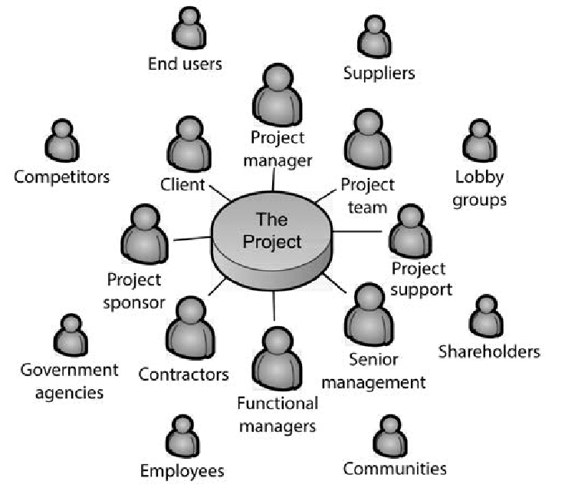
6. Software Engineering
  The word Engineer means “To Build”
Dept. of CSE, SOE, Presidency University

Slide 15
Software Engineering
Some realities:
  a concerted effort should be made to understand the problem before a software solution is developed
  design becomes a pivotal activity
  software should exhibit high quality
  software should be maintainable
Seminal definition by Fritz Bauer
  [Software engineering is] the establishment and use of sound engineering principles in order to obtain economical software that is reliable and works efficiently on real machines.
Dept. of CSE, SOE, Presidency University

Slide 16
Software Engineering
The IEEE definition:
  Software Engineering: (1) The application of a systematic, disciplined, quantifiable approach to the development, operation, and maintenance of software; that is, the application of engineering to software.
Dept. of CSE, SOE, Presidency University

Slide 17
Software Process
A process is a collection of activities, actions, and tasks that are performed when some work product is to be created.
An activity strives to achieve a broad objective (e.g., communication with stakeholders) and is applied regardless of the application domain, size of the project, complexity of the effort.
An action (e.g., architectural design) encompasses a set of tasks that produce a major work product (e.g., an architectural design model).
A task focuses on a small, but well-defined objective (e.g., conducting a unit test) that produces a tangible outcome.
Dept. of CSE, SOE, Presidency University

Slide 18
7. A Layered Technology
tools
methods
process model
a “quality” focus
Software Engineering Layers
Dept. of CSE, SOE, Presidency University

Slide 19
Life-Cycle Activity | Models | Methods & Tools | Standards
Software Management | Life-Cycle Process Model Work Breakdown Structure Constructive Cost Model (COCOMO) Project Plan Configuration Management (CM) Plan Risk Management Plan | Effort, Schedule and Cost Estimation Risk Analysis Data Collection Project Tracking CM Management Iterative/Incremental Development Agile Development | [IEEE 828] [IEEE 1058] [IEEE 1540] [IEEE 12207]
Software Requirements | Functional Model User Class Model Data Flow Diagram Object Model Formal Model User Stories | Requirements Elicitation Prototyping Structural Analysis Data-Oriented Analysis Object-Oriented Analysis Object Modeling Language (OML) Formal Methods Requirements Specification Requirements Inspection | [IEEE 830] [IEEE 1012] [IEEE 12207]
Software Design | Architectural Model Structure Diagram Object Diagram Class Specification Data Model | Structured Design Object-Oriented Design OML Modular Design Integrated Development Environment (IDE) Database Management System (DBMS) Design Review Refinement | [IEEE 1012] [IEEE 1016] [IEEE 12207] [IEEE 42010]
Software Construction | Detail Design Document Pseudocode Flow Chart Program Code Unit Test Plan Integration Test Plan | Detailed Design Functional Programming Object-Oriented Programming IDE DBMS Black Box/White Box Testing Basic Path Testing Unit Testing Code Review Proof of Correctness Software Reuse Integration Integration Testing | [IEEE 1008] [IEEE 1012] [IEEE 1016] [IEEE 12207]
Software Testing | System Test Plan Reliability Model Software Maintenance Process | Usability Testing System Testing Acceptance Testing Regression Testing Reliability Testing Non-Functional Software Testing | [IEEE 829] [IEEE 1012] [IEEE 12207]
Software Maintenance | Software Maintenance Process | Automated Testing Tools Maintenance Change Impact Analysis Inventory Analysis Restructuring Reverse Engineering Re-engineering | [IEEE 1219] [IEEE 12207] [IEEE 14764]
Dept. of CSE, SOE, Presidency University

Slide 20
8. A Process Framework
Process framework
  Framework activities
    work tasks
    work products
    milestones & deliverables
    QA checkpoints
  Umbrella Activities
Dept. of CSE, SOE, Presidency University

Slide 21
Framework Activities
Communication
Planning
Modeling
  Analysis of requirements
  Design
Construction
  Code generation
  Testing
Deployment
Dept. of CSE, SOE, Presidency University

Slide 22
9. Umbrella Activities
Software project management
Formal technical reviews
Software quality assurance
Software configuration management
Work product preparation and production
Reusability management
Measurement
Risk management
Dept. of CSE, SOE, Presidency University

Slide 23
Why Software Projects Fail?
  Unrealistic or unarticulated project goals
  Inaccurate estimates of needed resources
  Badly defined system requirements
  Poor reporting of the project's status
  Unmanaged risks
  Poor communication: clients, developers, & users
  Use of immature technology
  Inability to handle the project's complexity
  Sloppy development practices
  Poor project management
  Stakeholder politics
  Commercial pressures
Dept. of CSE, SOE, Presidency University

Slide 24
10. The Essence of Software Practice
Polya suggests:
    1. Understand the problem (communication and analysis).
    2. Plan a solution (modeling and software design).
    3. Carry out the plan (code generation).
    4. Examine the result for accuracy (testing and quality assurance).
Dept. of CSE, SOE, Presidency University

Slide 25
10.1 Understand the Problem
Who has a stake in the solution to the problem? That is, who are the stakeholders?
What are the unknowns? What data, functions, and features are required to properly solve the problem?
Can the problem be compartmentalized? Is it possible to represent smaller problems that may be easier to understand?
Can the problem be represented graphically? Can an analysis model be created?
Dept. of CSE, SOE, Presidency University

Slide 26
10.2 Plan the Solution
Have you seen similar problems before? Are there patterns that are recognizable in a potential solution? Is there existing software that implements the data, functions, and features that are required?
Has a similar problem been solved? If so, are elements of the solution reusable?
Can subproblems be defined? If so, are solutions readily apparent for the subproblems?
Can you represent a solution in a manner that leads to effective implementation? Can a design model be created?
Dept. of CSE, SOE, Presidency University

Slide 27
10.3 Carry Out the Plan
Does the solution conform to the plan? Is source code traceable to the design model?
Is each component part of the solution provably correct? Has the design and code been reviewed, or better, have correctness proofs been applied to algorithm?
Dept. of CSE, SOE, Presidency University

Slide 28
10.4 Examine the Result
Is it possible to test each component part of the solution? Has a reasonable testing strategy been implemented?
Does the solution produce results that conform to the data, functions, and features that are required? Has the software been validated against all stakeholder requirements?
Dept. of CSE, SOE, Presidency University

Slide 29
Hooker’s General Principles
Principle refers to “an important underlying law or assumption required in a system of thought”
1: The Reason It All Exists
2: KISS (Keep It Simple, Stupid!)
3: Maintain the Vision
4: What You Produce, Others Will Consume
5: Be Open to the Future
6: Plan Ahead for Reuse
7: Think!
Dept. of CSE, SOE, Presidency University

Slide 30
11. Software Myths
Myths refer to “erroneous beliefs about software and the process that is used to build it”
We already have a book that’s full of standards and procedures for building software. Won’t that provide my people with everything they need to know?
If we get behind schedule, we can add more programmers and catch up (sometimes called the “Mongolian horde” concept).
If I decide to outsource the software project to a third party, I can just relax and let that firm build it.
Dept. of CSE, SOE, Presidency University

Slide 31
Software Myths
Customer Myths
Software requirements continually change, but change can be easily accommodated because software is flexible.
Practitioner’s Myths
Once we write the program and get it to work, our job is done.
The only deliverable work product for a successful project is the working program.
Software engineering will make us create voluminous and unnecessary documentation and will invariably slow us down.
Dept. of CSE, SOE, Presidency University

